Slide 1

AI-Powered Virtual Tailor System
Revolutionising custom fit through intelligent data strategy

Slide 2
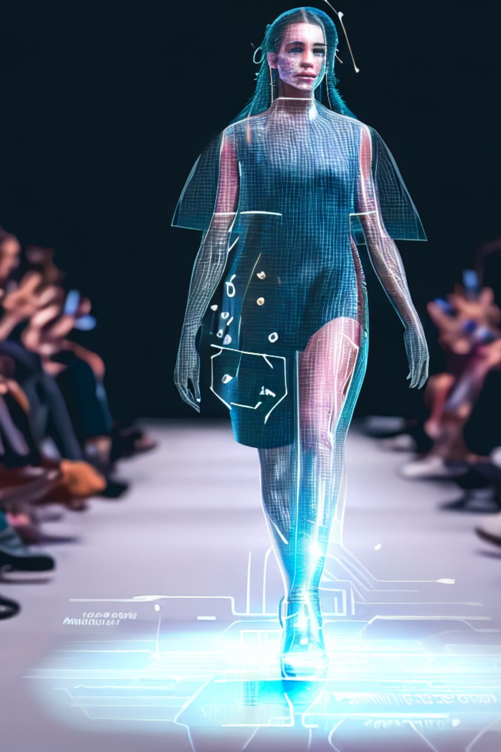
Executive Summary
The Vision
Strategic Value
Transform smartphone cameras into precision measurement tools using computer vision and machine learning for perfect-fit garments
Eliminate costly alterations, reduce returns by 65%, and scale personalised tailoring to millions whilst maintaining data privacy
Compliance First
Built on GDPR, CCPA standards with AES-256 encryption, ensuring responsible AI practices and transparent user consent

Slide 3
The Market Opportunity
Industry Pain Points
$350B
Traditional tailoring requires multiple in-person visits, limiting scalability and customer reach
Global Tailoring Market
Online fashion faces 30-40% return rates due to poor fit, costing retailers billions annually
Projected by 2028
Custom measurements are expensive, time-consuming, and inconsistent across different tailors
40%
Emerging markets lack access to quality tailoring services despite growing purchasing power
Return Rate
Due to sizing issues

Slide 4
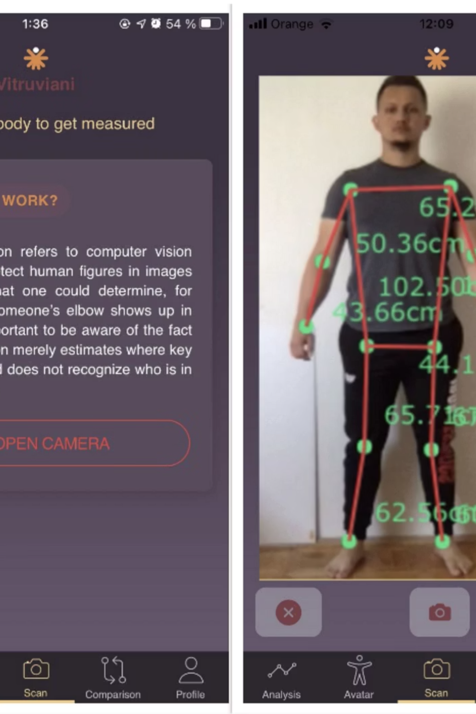



How It Works: Capture to Garment
Smart Capture
Automated guidance system directs users through pose sequences whilst validating camera angle and distance in real-time
AI Analysis
Computer vision models extract 40+ body measurements with millimetre precision using calibration algorithms
Perfect Fit
Measurements integrate directly with tailoring systems for personalised pattern generation and production

Slide 5





Data Collection Architecture
Visual Data
Measurement Data
Body images captured via front/side angles
40+ body dimensions extracted automatically
Optional reference photos for style preferences
Pose validation metrics and confidence scores
Context Metadata
Interaction Data
Device specifications for calibration accuracy
User feedback on fit accuracy
Lighting conditions and camera parameters
Model performance analytics for continuous improvement
All data collection occurs with explicit user consent and transparent disclosure of usage purposes

Slide 6



Security & Storage Framework
Multi-Layer Protection
01
Encryption at Rest
AES-256 encryption for all stored images and measurement data with key rotation protocols
99.9%
02
Secure Transmission
TLS 1.3 for all data transfers between devices and cloud infrastructure
Uptime SLA
Enterprise reliability
03
Access Controls
Role-based permissions ensuring only authorised personnel access specific data categories
04
<100ms
Audit Trails
Comprehensive logging of all data access and modification events for compliance verification
Response Time
Real-time processing
100%
Data Sovereignty
Regional compliance

Slide 7
Data Usage: Training World-Class Models
Initial Model Training
1
Large-scale open datasets combined with synthetic data ensure diverse body type representation and eliminate demographic bias
2
Real-Time Inference
Trained models process user images locally on-device where possible, minimising cloud dependency and latency
Continuous Improvement
3
Opted-in user data refines accuracy across edge cases, with quarterly model updates improving measurement precision
4
Analytics & Insights
Aggregated, anonymised data reveals population trends, helping tailors optimise inventory and sizing strategies

Slide 8





Privacy & Compliance Excellence
Transparent Consent
Granular opt-in controls allowing users to separately consent for measurement service versus model improvement contributions
Data Minimisation
Raw images deleted within 24 hours unless explicit consent given; only extracted measurements retained for service delivery
Global Standards
Full GDPR and CCPA compliance with data localisation options and right-to-be-forgotten implementation within 30 days
Ethical AI
Regular bias audits across age, gender, ethnicity, and body type ensure fairness with published diversity metrics

Slide 9


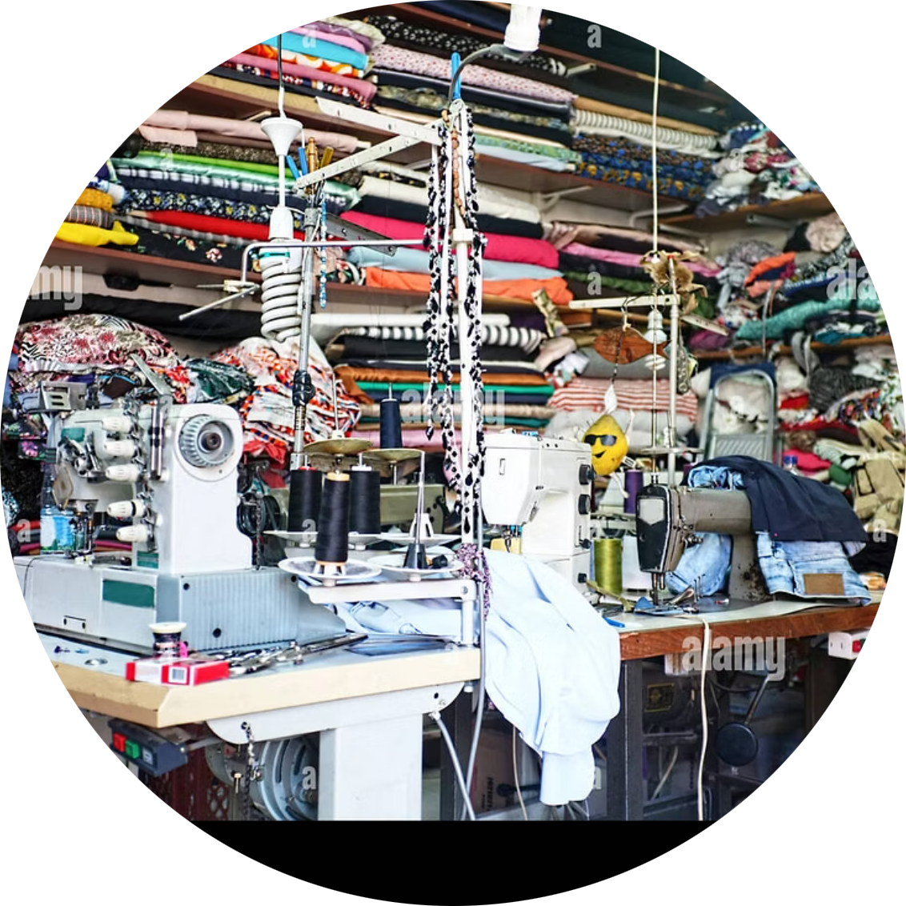
Stakeholder Value Proposition
For Retailers & Brands
For End Customers
For Tailoring Businesses
Reduce returns by 65%, eliminate alteration costs, and increase customer lifetime value through perfect-fit satisfaction
Convenient at-home measurement in under 2 minutes, consistent sizing across brands, and confidence in online purchases
Scale operations without physical constraints, access new markets globally, and focus on craftsmanship over measurement
"This technology democratises access to custom-fit clothing whilst preserving the artistry of traditional tailoring"

Slide 10




Next Steps: Building Together
Partnership Engagement
Collaborate with pilot retailers and tailoring houses to refine the product-market fit
Beta Testing Programme
Launch controlled trials across diverse demographics to validate accuracy and user experience
Market Launch
Scale platform with robust infrastructure, compliance certifications, and strategic go-to-market execution
Ready to revolutionise fit?
Join us in creating the future of personalised fashion

Slide 11
Thank you!!

